Slide 1






⥫
Maximizing Efficiency: A Deep Dive into
eShopExpress Website

Slide 2
Team Member
Supervisor:- Dr. Shashank Bhardwaj
Shashi Ranjan Jha(Team Leader)
Sharad Nirankari
Group no- GB 25

Slide 3





Introduction
Welcome to the deep dive into eShopExpress Website and how to maximize efficiency. This presentation will explore the key strategies and tools to enhance website performance and user experience
.

Slide 4





Understanding eShopExpress
An overview of the its capabilities for
platform and
. Exploring
the key features and functionalities that
contribute to and
.

Slide 5






Optimizing Website Speed
Strategies for improving
and
. Discussing techniques such as
,
, and .

Slide 6

Login Page

Slide 7
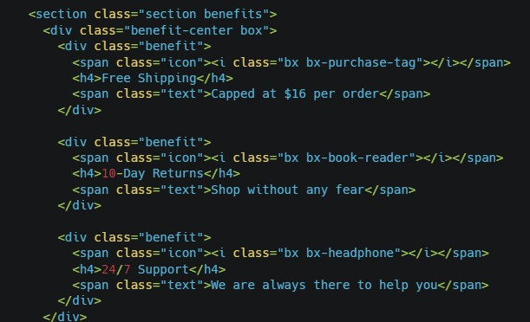
Code for Loging Page

Slide 8

Website Design

Slide 9


Responsive Design
The importance of for
. Exploring the impact of and best practices for
.

Slide 10

Enhancing User Experience
Strategies to elevate
,
and
the impact on
through
,
. Exploring
.

Slide 11





Utilizing Analytics
The significance of understanding
in and
. Discussing the
to make
.
use of informed

Slide 12






Security Measures
The importance of
in maintaining and
. Discussing
,
, and
.

Slide 13

Measuring Success
Key
and
to measure the
of the website.
and
Discussing the importance of
.

Slide 14



Conclusion
In conclusion, maximizing efficiency on the eShopExpress Website
requires a holistic approach encompassing ,
, , , and strategies, businesses can achieve
.
. By implementing these
and

Slide 15











Thanks!
Where to you communicate
shashiranjanha30@gmail.com
+91 6307813788

